Slide 1
WhaleWatch: Using Satellite Data and Habitat Models to Assist Management in Reducing Human Impacts on Whales
H. Bailey, B. Mate, S. Bograd, D. Palacios, E. Hazen, K. Forney and E. Howell
Notes:
I’m here representing Helen Bailey, who’s the lead PI
Collaborators from UMCES, OSU & NOAA
This is a 3-yr project; we’re at ~ 8 mos.

Slide 2
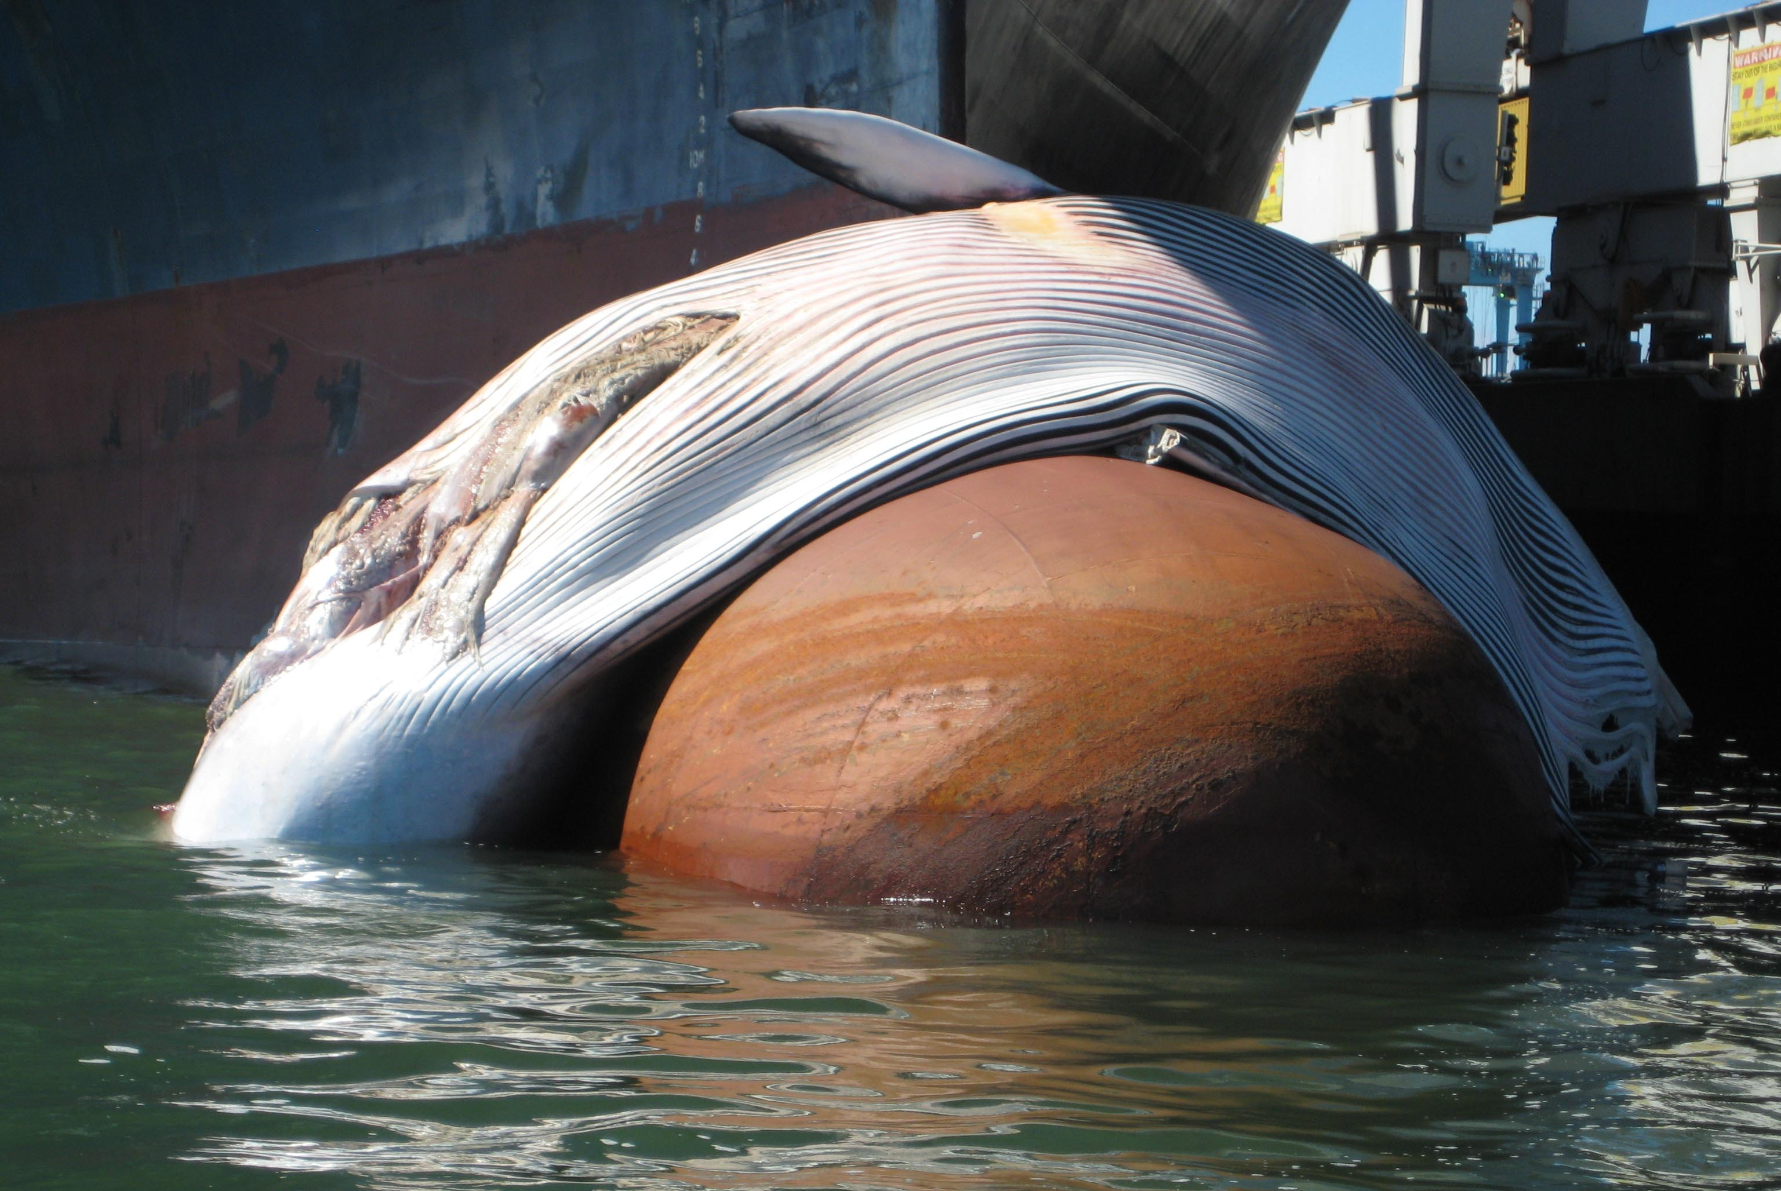
Outline
Goals
Approach
Satellite telemetry data
Remotely sensed environmental data
Preliminary blue whale habitat model results
Transition to the partner
Next steps
Notes:
Motivation:
Anthropogenic impacts including collisions with vessels, entanglement in fishing gear and underwater noise are major sources of injury and mortality to large whales
Along the California coast alone there were 21 blue whale strandings during 1988 to 2007, of which eight were confirmed as ship strikes
A priority issue for NOAA is to reduce the number of ship strikes and entanglements in fishing gear for large whales

Slide 3
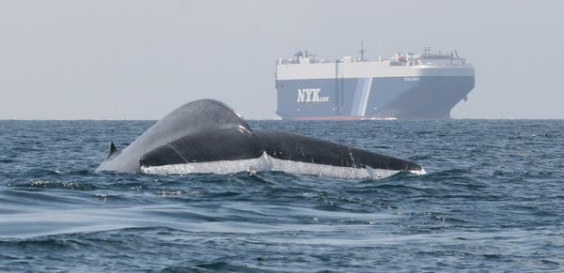
Goals
Use satellite data to develop habitat models that will allow us to identify large whale hotspots and provide a tool for predicting occurrence in the California Current System. This will assist management efforts to mitigate against human impacts.

Slide 4
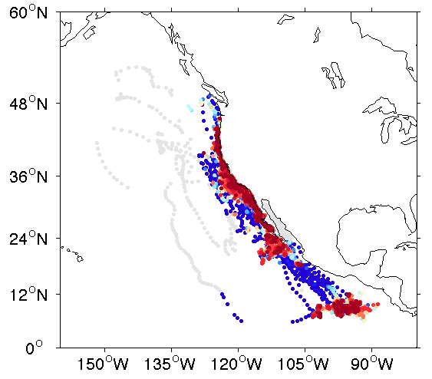
Approach
Apply a state-space model to provide regularized daily positions from whale satellite telemetry data
Develop habitat preference models using RS data
Identify hotspots for blue, fin, humpback, and gray whales
Develop a new decision support tool for NOAA that can predict the probability of whale occurrence

Slide 5
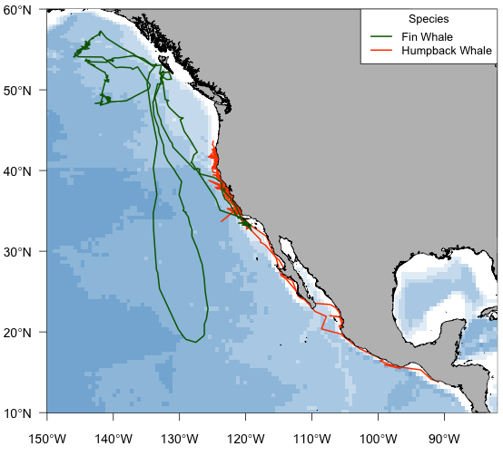
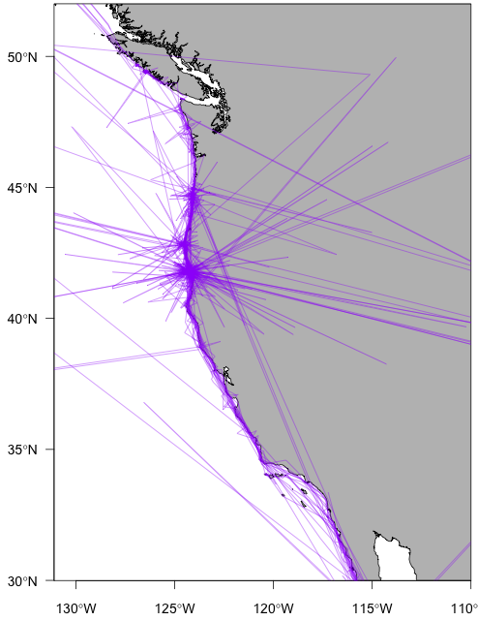
Whale Satellite Telemetry Data
Whale species: Blue Fin Humpback Gray
No. tags: 128 2 15 35
Years: 1993-2008 2004, 2006 2004-2005 2005, 2009
Notes:
Status of track analysis:
Blue whales: State-space model run on all of the tracks up to present resulting in 104 tracks. Fin whales: SSM run on 1 track and just completing the second. Humpback and gray whales: Have all of the raw satellite tracks (15 humpbacks and 35 grays), but haven't yet applied SSM. Plan to complete this by the end of the first year.
Showing the unfiltered GW is an effective way to communicate the need for applying the SSMs (especially for applications in the coastal ocean).

Slide 6
RS Variables
Table 1. Sources and characteristics of digital data products used in deriving 20 predictor variables for use in habitat modeling. Data sets accessed through CoastWatch's data pass-through services are indicated^{a, c}.
Variable | Derived from | Product/Sensor/Satellite platform | Grid resolution | Temporal resolution | Source | Web site | Reference
Sea surface height anomalyª | -- | Merged (Topex/Poseidon, ERS-1/-2, Geosat, GFO, Envisat, Jason-1/-2) | 0.3333 deg^{d} | 1 day | AVISO | http://www.aviso.oceanobs.com/ | Ducet et al. (2000)
Sea surface heightª | SSHA + MDT | Merged (Topex/Poseidon, ERS-1/-2, Geosat, GFO, Envisat, Jason-1/-2) | 0.3333 deg^{d} | 1 day | AVISO | http://www.aviso.oceanobs.com/ | Rio et al. (2011)
Eddy kinetic energy | Geostrophic current anomaly vectors [u', v'] | Merged (Topex/Poseidon, ERS-1/-2, Geosat, GFO, Envisat, Jason-1/-2) | 0.3333 deg^{d} | 1 day | AVISO | http://www.aviso.oceanobs.com/ | Ducet et al. (2000)
Ekman pumping^{a, b} | Wind stress curl | Seawinds/QuikSCAT | 12.5 km | 8 day | NASA/JPL | http://winds.jpl.nasa.gov/; http://www.remss.com/ | Risien and Chelton (2008)
Front probability 10-dayª | Sea surface temperature | Imager/GOES | 0.05 deg | 10 day | NOAA/NESDIS | http://www.oso.noaa.gov/goes/index.htm | Castelao et al. (2006)
Front probability 30-dayª | Sea surface temperature | Imager/GOES | 0.05 deg | Monthly | NOAA/NESDIS | http://www.oso.noaa.gov/goes/index.htm | Castelao et al. (2006)
Sea surface temperatureª | -- | AVHRR Pathfinder v. 5 (day and night) | 4.4 km | 5 day | NOAA/NESDIS | http://www.nodc.noaa.gov/sog/pathfinder4km/ | Kilpatrick et al. (2001)
Sea surface temperature^{a, b} | -- | Blended (AVHRR/POES, Imager/GOES, MODIS/Aqua, AMSR-E/Aqua) | 11 km | 5 day | NOAA/NESDIS | http://coastwatch.pfeg.noaa.gov/infog/BA_ssta_las.html | Powell et al. (2008)
SST gradient | Sea surface temperatureª | AVHRR Pathfinder v. 5 (day and night) | 4.4 km | 5 day | NOAA/NESDIS | http://www.nodc.noaa.gov/sog/pathfinder4km/ | --
Chlorophyll-a concentrationª | -- | SeaWiFS/Orbview-2 | 8.8 km | 8 day | NASA/GSFC | http://oceancolor.gsfc.nasa.gov/ | McClain (2009)
Chlorophyll-a concentrationª | -- | MODIS/Aqua | 4.4 km | 8 day | NASA/GSFC | http://oceancolor.gsfc.nasa.gov/ | McClain (2009)
Primary productivity^{a, b} | Chlorophyll-a concentration, sea surface temperature, photosynthetically active radiation | SeaWiFS/Orbview-2; OISST v.2 | 8.8 km | 8 day | NASA/GSFC; NOAA/NESDIS | http://oceancolor.gsfc.nasa.gov/; http://www.ncdc.noaa.gov/oa/climate/research/sst/sst.php | Behrenfeld and Falkowski (1997)
Primary productivity^{a, b} | Chlorophyll-a concentration, sea surface temperature, photosynthetically active radiation | MODIS/Aqua | 4.4 km | 8 day | NASA/GSFC; NOAA/NESDIS | http://oceancolor.gsfc.nasa.gov/; http://www.ncdc.noaa.gov/oa/climate/research/sst/sst.php | Behrenfeld and Falkowski (1997)
Bottom depth^{c} | -- | SRTM30_PLUS v.6.0 | 0.0083 deg | -- | UCSD/SIO | http://topex.ucsd.edu/WWW_html/srtm30_plus.html | Becker et al. (2009)
Bottom slope | Digital bathymetry^{c} | SRTM30_PLUS v.6.0 | 0.0083 deg | -- | UCSD/SIO | http://topex.ucsd.edu/WWW_html/srtm30_plus.html | --
Bottom aspect (northness & eastness) | Digital bathymetry^{c} | SRTM30_PLUS v.6.0 | 0.0083 deg | -- | UCSD/SIO | http://topex.ucsd.edu/WWW_html/srtm30_plus.html | --
Distance to shelf break | Digital bathymetry^{c} | ETOPO2 v.2g | 0.0333 deg | -- | NOAA/NGDC | http://www.ngdc.noaa.gov/mgg/global/etopo2.html | --
Distance to coast | Digital shoreline | GSHHS v.1.10/intermediate | -- | -- | NOAA/NGDC | http://www.ngdc.noaa.gov/mgg/shorelines/gshhs.html | Wessel and Smith (1996)
Biogeographic province | -- | Longitude/latitude polygons defining Longhurst's biogeographic provinces | -- | -- | VLIMAR/VLIZ | http://www.vliz.be/vmdcdata/vlimar/index.php | Longhurst (2006); VLIZ (2009).

Slide 7
Ecological Considerations
BWs depend exclusively on dense krill aggregations for food and must forage constantly
BW large-scale distribution must be dictated by regions where krill patches reliably develop and can be exploited
A simple ‘upwelling-diatoms-krill’ food chain creates these conditions. This pathway has a predictable large-scale environmental mechanism.
BWs should focus their ARS behavior in these regions and therefore large-scale blue whale movement behavior should be predictable on the basis of environment.

Slide 8
Blue Whale Habitat Modeling
Specify response variable & account for position error
Formulate hypotheses linking whale movement behavior to krill aggregation mechanisms & specify relevant environmental covariates
Run NPMR models on gridded & stratified data by province and season
Assess model skill with validation data set
Extend prediction to full region (NE Pacific)

Slide 9
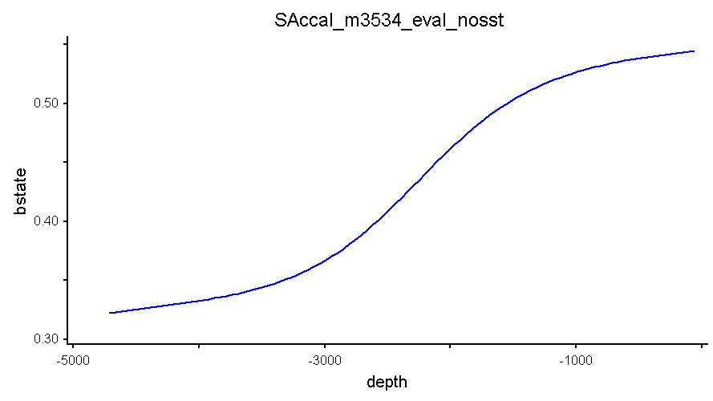
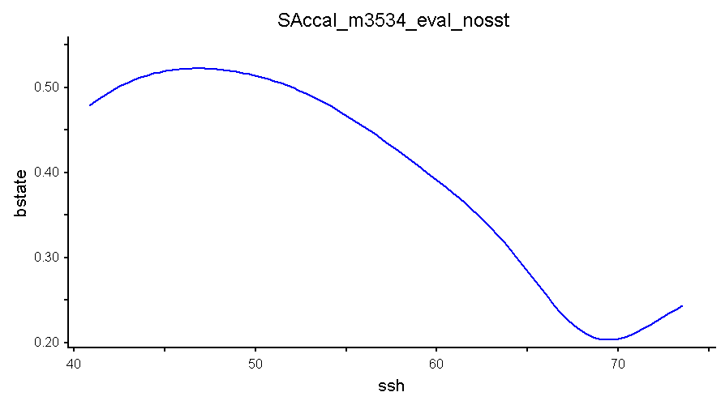
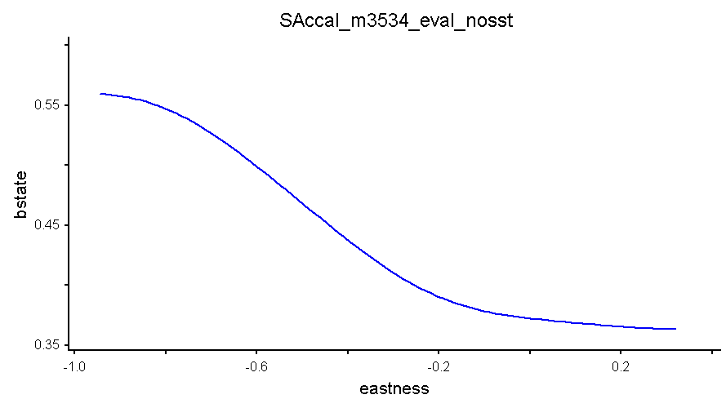
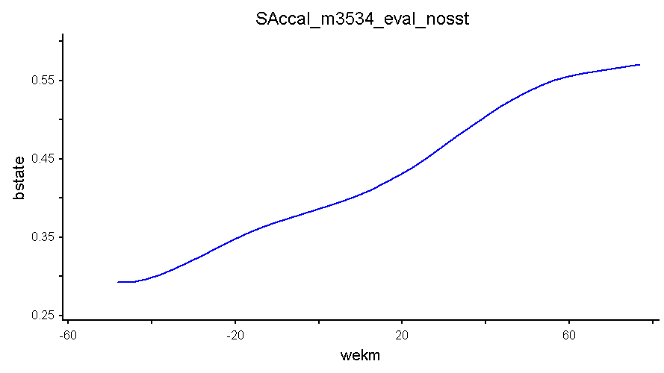
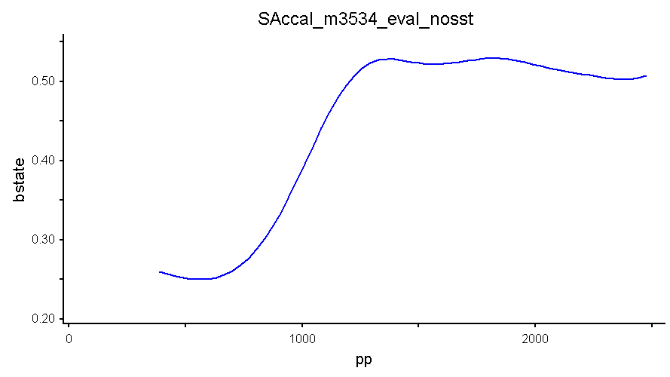
Preliminary Results
CALIFORNIA CURRENT – SUMMER/AUTUMN
BSTATE ~ DEPTH x EASTNESS x SSH x WEKMN x PP
xR² = 0.302, N = 282
Predictors | Tolerance | Sensitivity
DEPTH | 1394.00 | 0.068
EASTNESS | 0.13 | 0.365
SSH | 3.51 | 0.364
WEKMN | 236.20 | 0.008
PP | 521.50 | 0.223
Notes:
Best model with 5 variables: depth, eastness, ssh, wekm, pp
3 variables: northness, slope, distshelf not useful

Slide 10
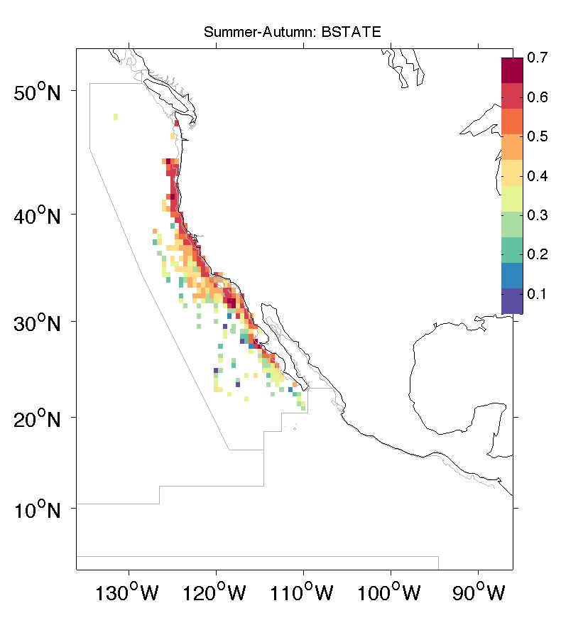
Preliminary Results

Slide 11
Conclusions
ARS behavior was most intense and extensive on the shelf over westward facing slopes, suggesting that topographic features are good predictors of krill aggregation.
Oceanographic conditions associated with most intense ARS included a high primary productivity, low SSH, and positive WEKMN.
The likelihood of foraging behavior in response to environmental variables was captured by hump-shaped or otherwise nonlinear functions
These responses indicate that blue whales optimize foraging behavior along environmental gradients, making it a useful measure of ecological performance

Slide 12
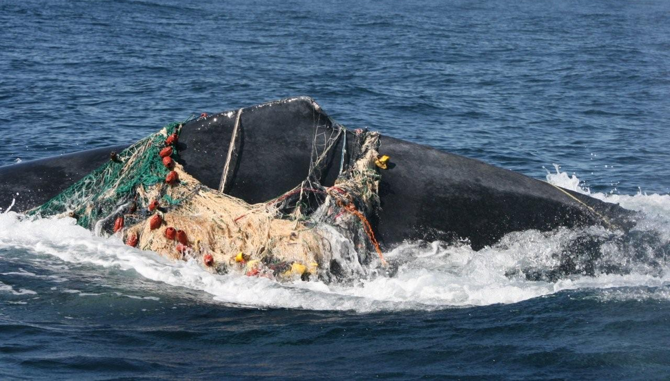
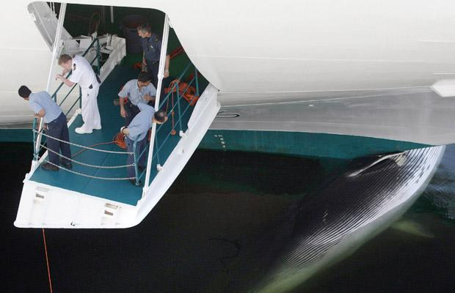
Partner and Transitioning
The habitat models will be developed into a tool, “WhaleWatch”, and transitioned to the partner NOAA/NMFS Southwest Regional Office to provide information on whale distribution and hot spots.
This will assist with their efforts to establish policies to reduce the number of ship strikes and whale entanglements.
The WhaleWatch tool will also be hosted on the NOAA website to benefit other agencies and stakeholders.

Slide 13
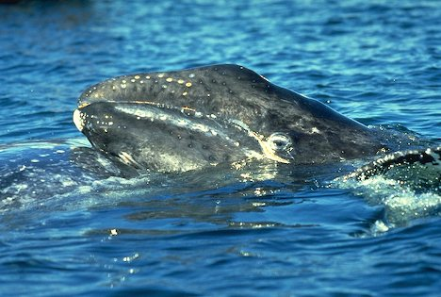
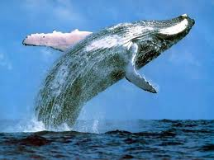
Next Steps
Meet with partner and other stakeholders to determine requirements for WhaleWatch tool and how it can best assist management
Complete application of state-space model to all whale tracks
Complete blue whale habitat model and assessment of most appropriate modeling techniques

Slide 14
Acknowledgements
Funding was provided under the interagency NASA, USGS, National Park Service, US Fish and Wildlife Service, Smithsonian Institution Climate and Biological Response program, Grant Number NNX11AP71G.
Dave Foley provided useful discussions about the data sets served by Coastwatch.
The support of field crews was essential to the success of the tagging operations. Tagging was supported by private donors to the MMI Endowment at OSU, as well as the support from ONR and the Sloan, Packard and Moore foundations to the TOPP program.

Slide 15
Thank you!

